Slide 1
AM TRANSMITTER
ANALOG COMMUNICATIONS SYSTEMS PROJECT WORK
ASARE Kwabena Ayew 9759213
OFORI-AMPOFO Nana Yaw Owusu 9763913
DARKU Cyril Ofei 9761013
AMUNA Andrew Mbabilla 9657913
ZWENNES Ann-Marie 9766613

Slide 2
building AN AM TRANSMITTER
The AM Transmitter was built using the following components:
100K Resistors (3)
3.3K Resistors (2)
2N2222 NPN Transistor
10uF Capacitor
0.1uF Capacitor
Male Audio Jack
Antennae
9V Battery

Slide 3
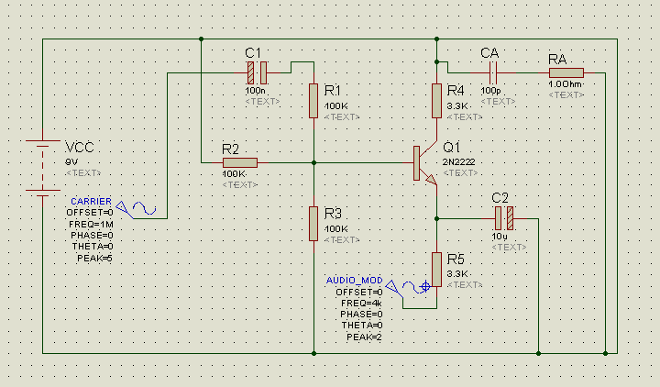
SCHEMATIC

Slide 4
WORKING PRINCIPLE
The oscillator which, in this case, is the programmed Arduino board generates the carrier frequency set at 1MHz.
The input from the audio jack is the modulating signal.
The audio signal is amplified by the NPN Transistor in its emitter resistance circuit. The transistor is of common emitter configuration.
The amplified audio signal and carrier wave are fed to the modulator. Audio signal and carrier are superimposed in a suitable manner.
This process of modulation produces radio waves.
Radio waves from transmitter are fed to the antennae from where they are transmitted.

Slide 5
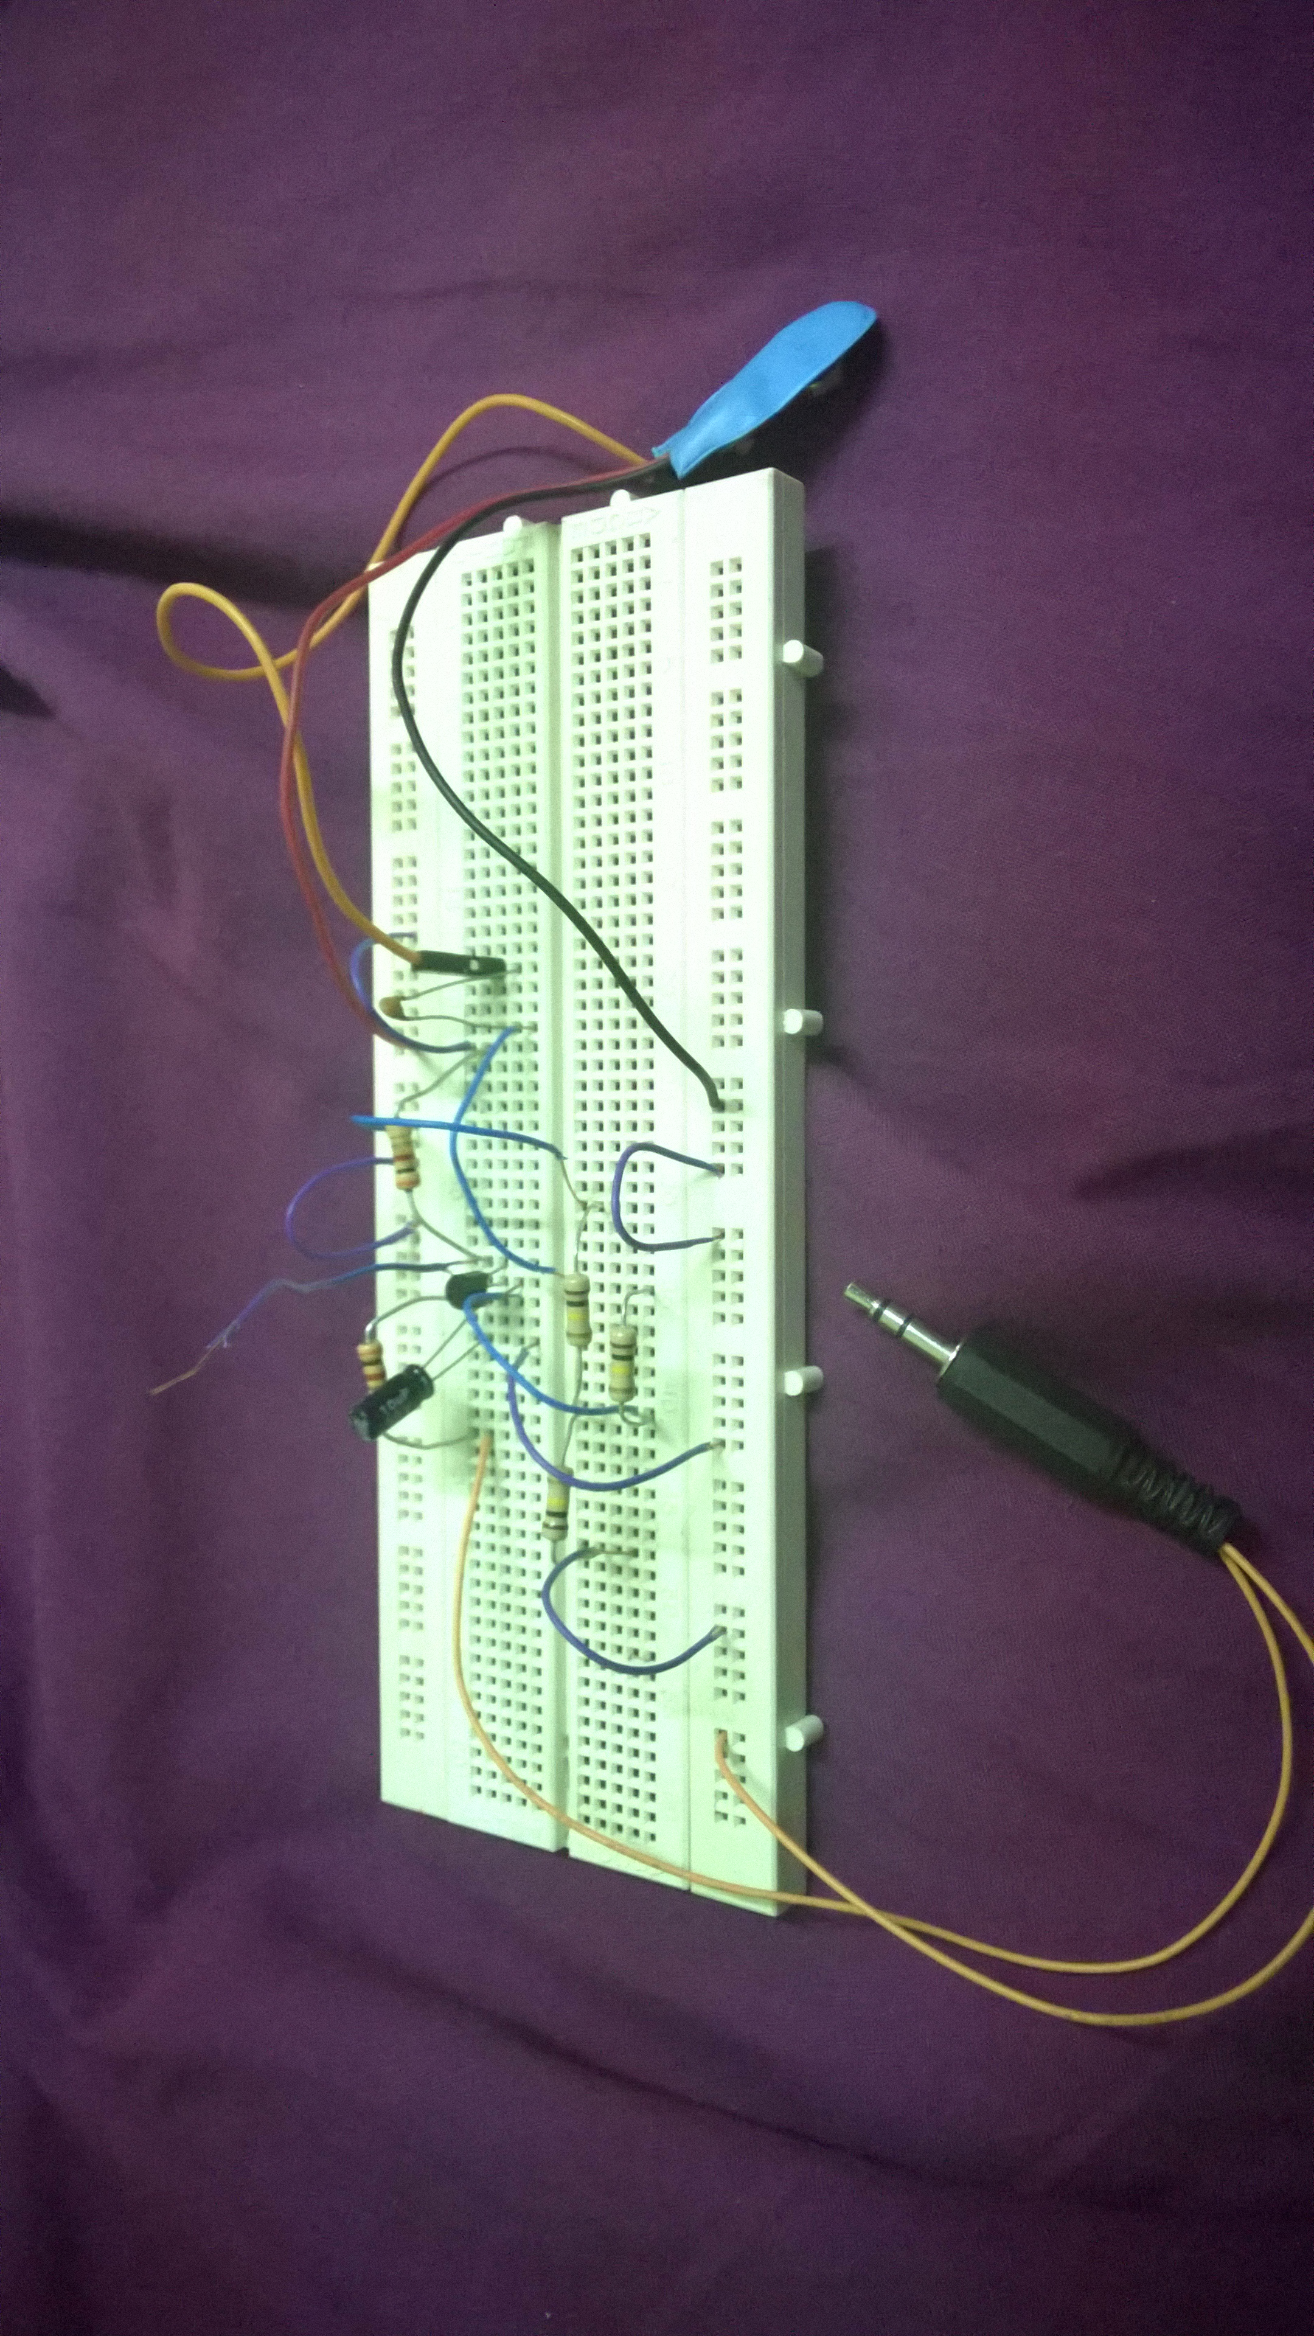
MODULATING CIRCUIT

Slide 6
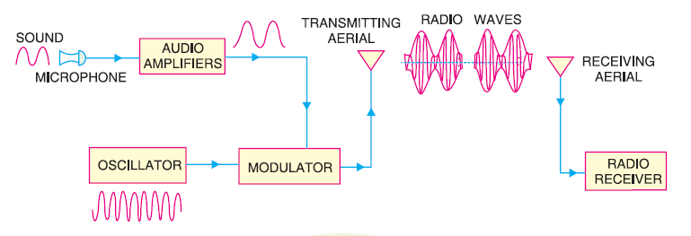
Block diagram
Reference: Principles of Electronics – V.K. Mehta, published by S. Chand, 2008

Slide 7
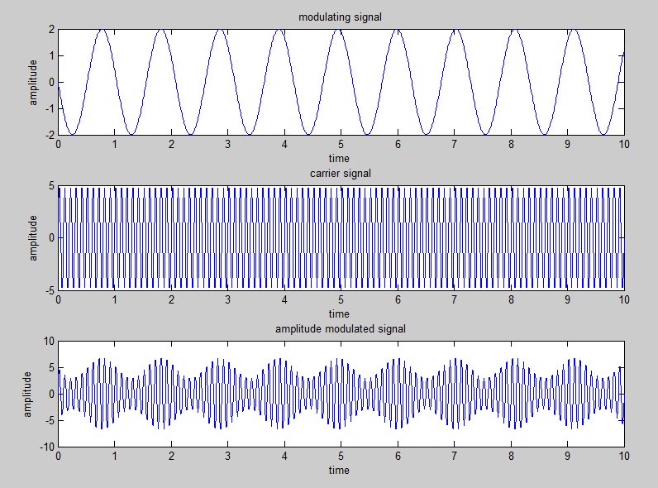
WAVEFORMS

Slide 8
APPENDIX A – Arduino program code
#define myOutputPin 9
void setup ()
{
pinMode (myOutputPin, OUTPUT);
TCCR1A = 0;
TCCR1B = 0;
TCNT1 = 0;
OCR1A = 7; // toggle after counting to 8
TCCR1A |= (1 << COM1A0); // Toggle OC1A on Compare Match.
TCCR1B |= (1 << WGM12); // CTC mode
TCCR1B |= (1 << CS10); // clock on, no pre-scalor
}
void loop() {
// put your main code here, to run repeatedly:

Slide 9
Appendix b – matlab code
Em=2;
fm=-0.96;
wm=2*pi*fm;
t=0:0.01:10
ms=Em*sin(wm*t)
subplot(3,1,1)
plot(t,ms)
xlabel('time')
ylabel('amplitude')
title('modulating signal')
Ec=5;
fc=10;
wc=2*pi*fc;
t=0:0.01:10
cs=Ec*sin(wc*t);
subplot(3,1,2)
plot(t,cs);
xlabel('time')
ylabel('amplitude')
title('carrier signal')
m=Em/Ec;
am=Ec*(1+(m*sin(wm*t))).*sin(wc*t);
subplot(3,1,3)
plot(t,am);
xlabel('time')
ylabel('amplitude')
title('amplitude modulated signal')

Slide 10


